Slide 1
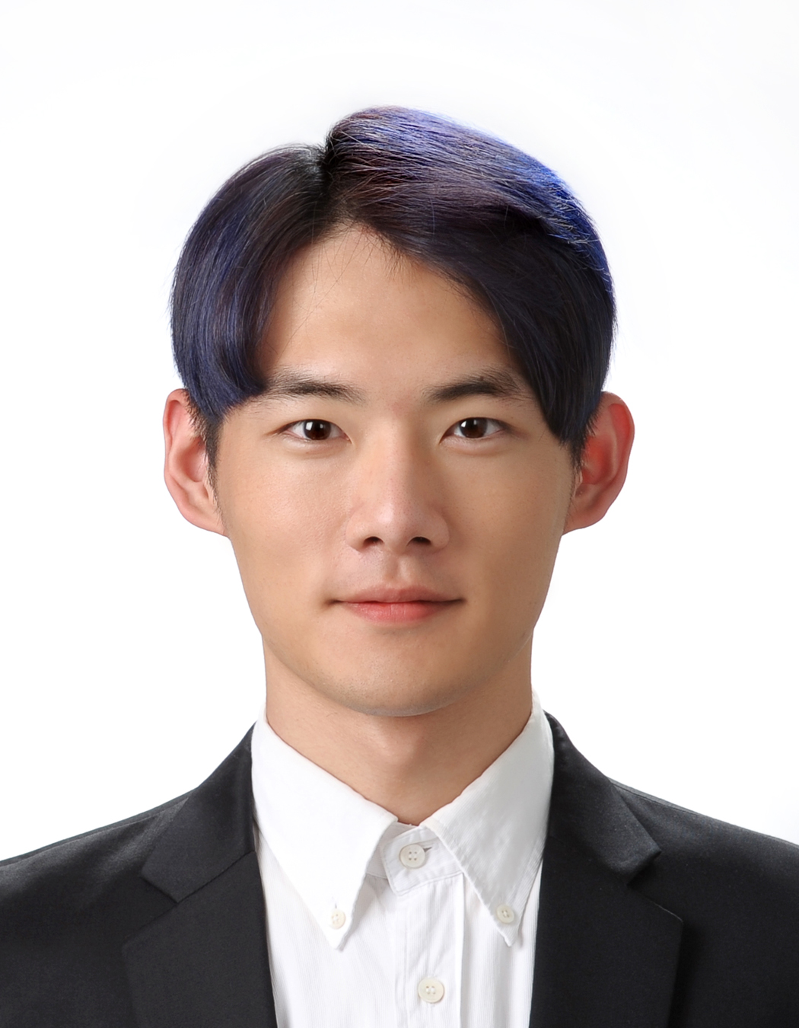
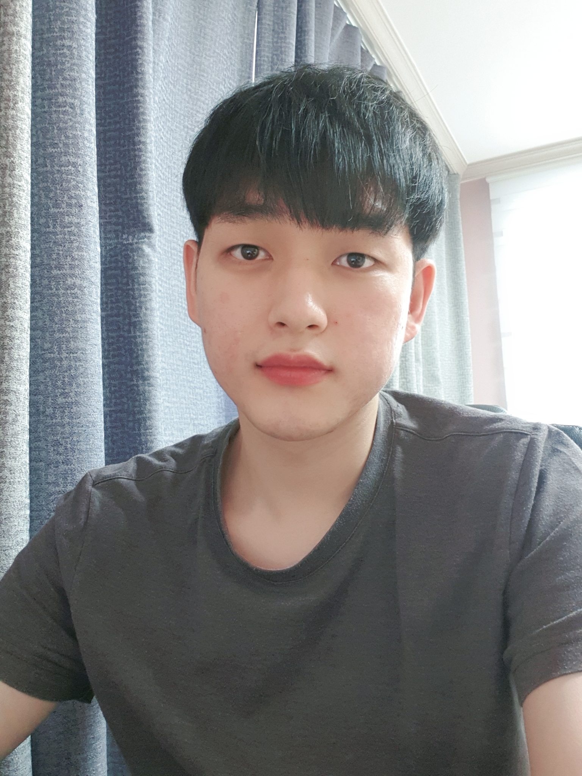
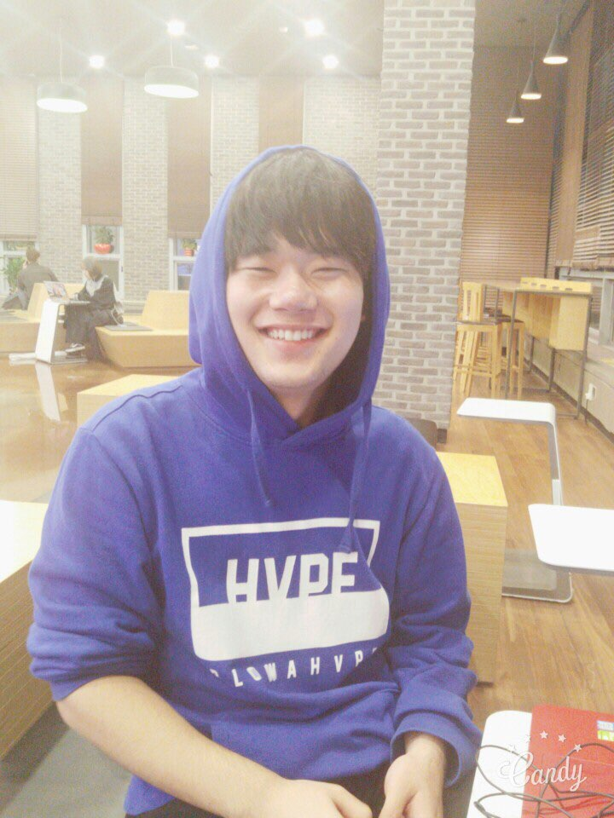
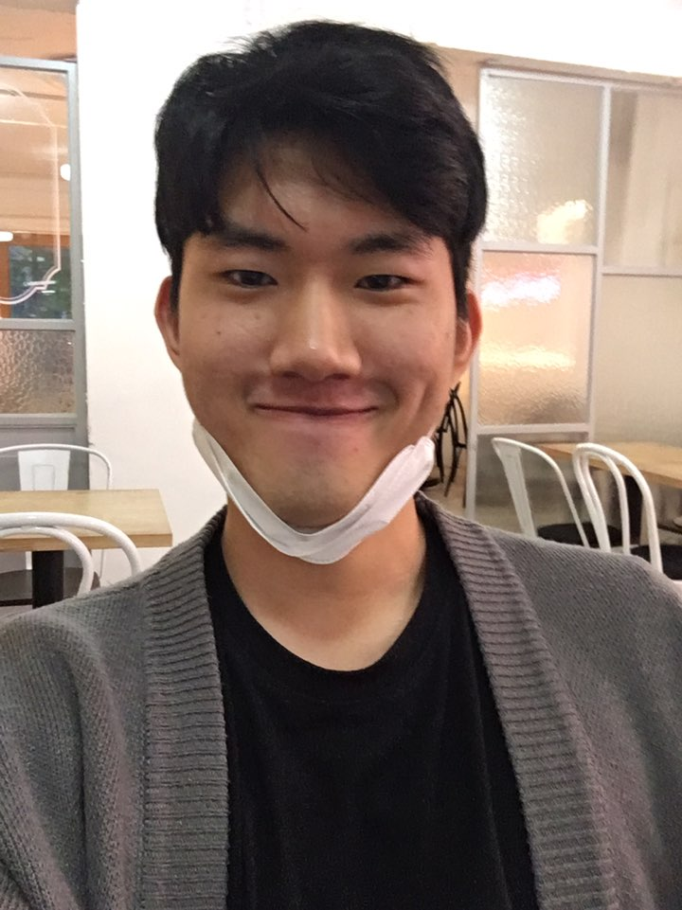
TEAM 2
15146314
Yang Seung Hyuck
16102289
Jeon Jong Hyun
16102292
Choi Woo Seok
16102279
Son Min Sang

Slide 2
Contents
Back ground
A
B
Background
-Why we select this
-Source
-Data
Target
-For who
-What kind of function
Target
C
D
Architecture
-Data Set
-Physical Schema
-User Interface
Future Plan
Architecture
Future plan

Slide 3
01
Back ground
• Why we select this • Source • Data

Slide 4

Background – Why we select this topic
Background
Where are we going in this weekend?
Target
I’d like to eat Chinese food,
visit a board game cafe,
and take a picture at the beautiful place.
Architecture
Isn't there a place to be satisfied with all of your favors?
Future plan

Slide 5
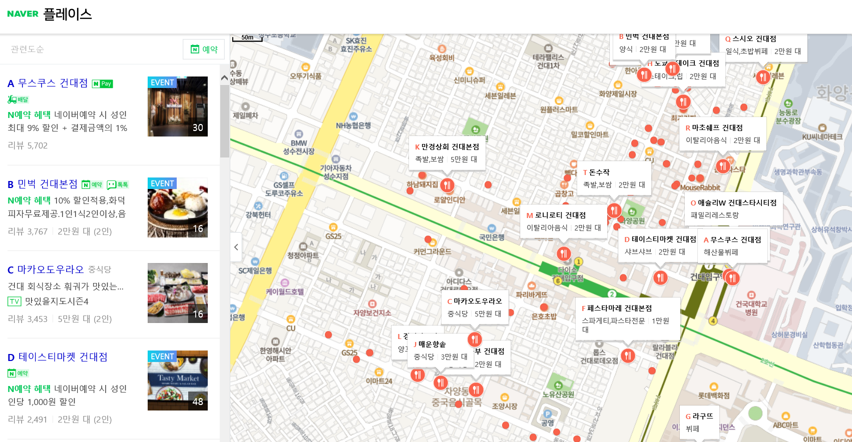
Background – Where we get data source
Background
Target
Architecture
Future plan
Notes:
We collect data from Naver Place with crawling.
The data contain name of market, the number of review, url to link with the naver page which provide the information of market, image of market

Slide 6
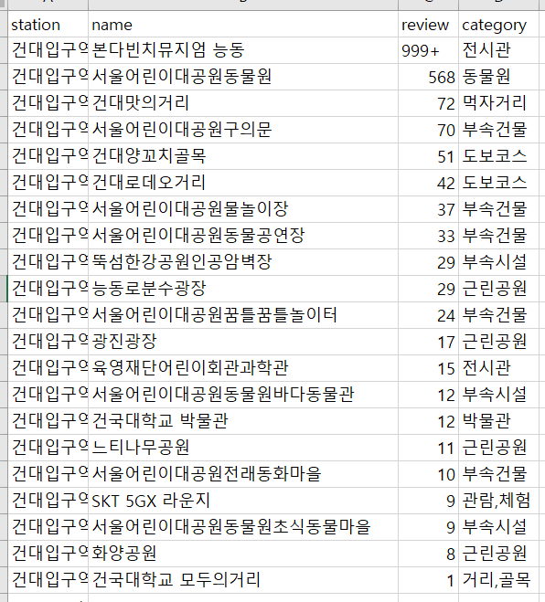
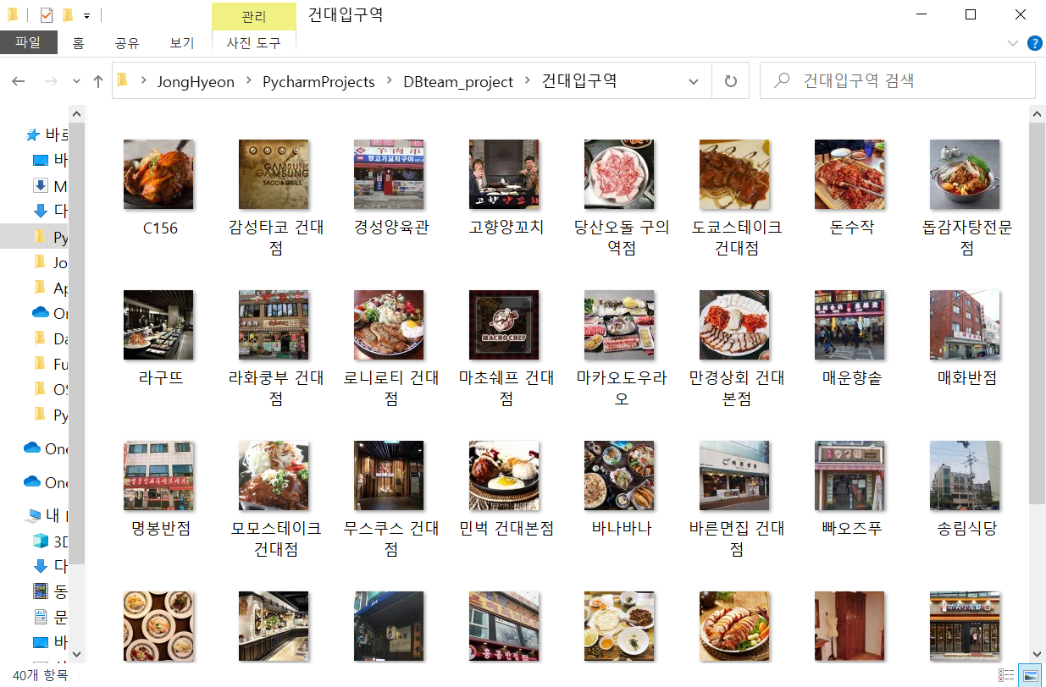
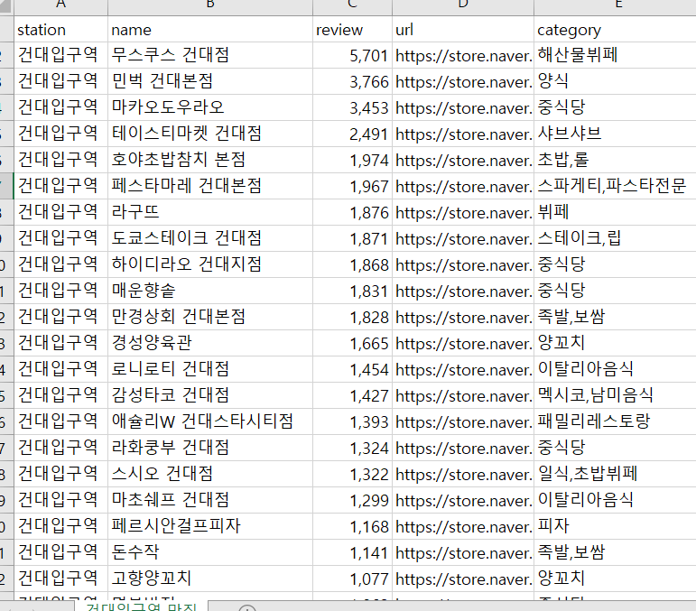
Background – Data
Background
Target
Architecture
Future plan
Notes:
We stored the data into Excel file

Slide 7
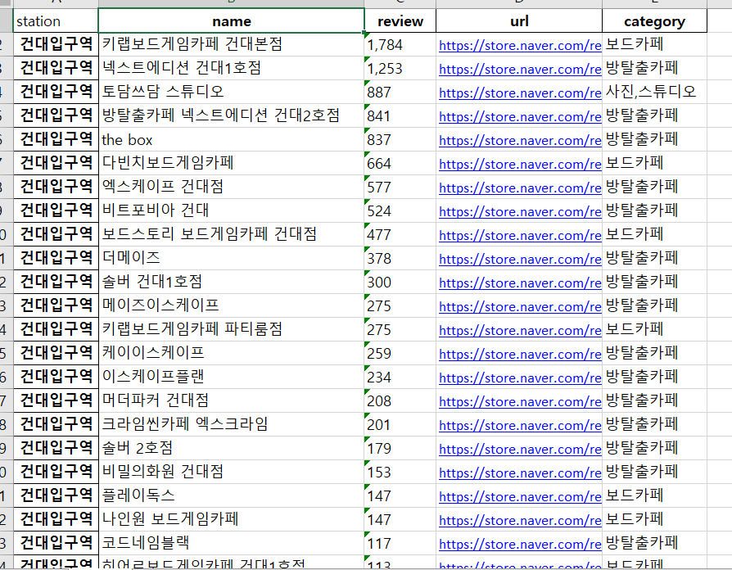
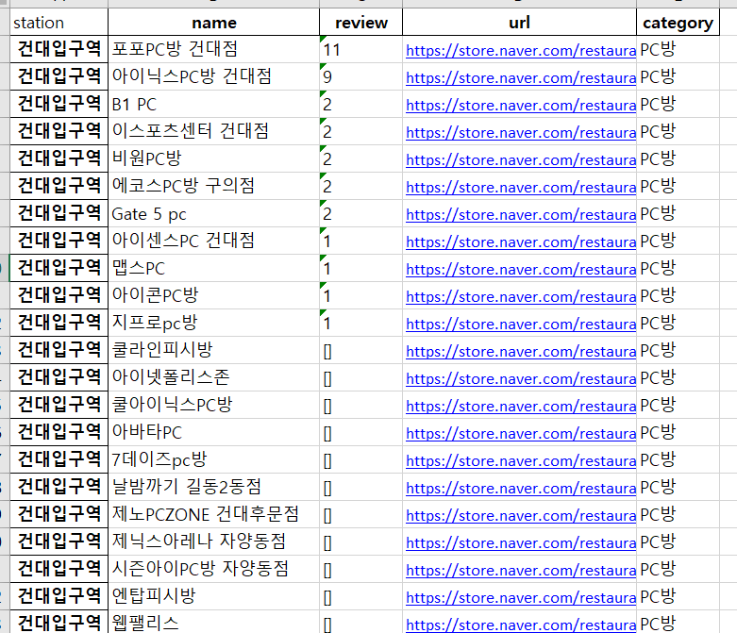
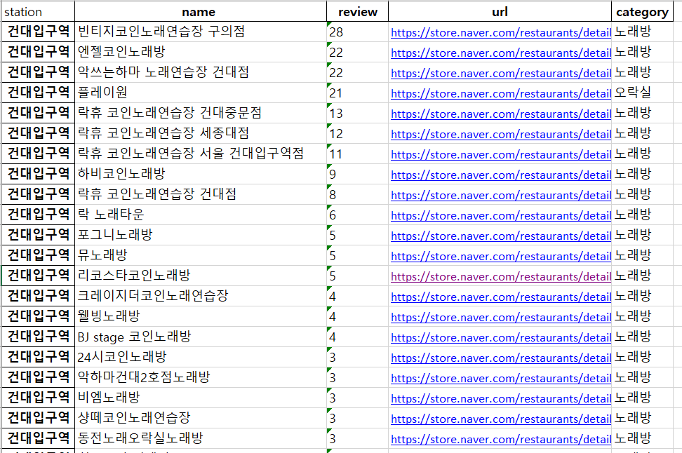
Background – Data
Background
Target
Architecture
Future plan

Slide 8
02
Target
• For who • What kind of function

Slide 9
Target – For Who?
Background
People who want to find a place where satisfy their demand.
- Couple who has difficulties in choosing date place.
- Friends who are bored in playing at the same place.
- People who want to go out with their parents.
Target
Architecture
Future plan

Slide 10
Target – What kind of function
Background
People can select several categories in food, entertainment, attraction according to their needs.
Checking several categories-> Show the stations that satisfy the user’s needs
The results are ranks of the stations with scores which are measured with the number of categories which they chose before.
Target
Architecture
Future plan

Slide 11
03
Architecture
• Data set • Physical schema • User interface

Slide 12
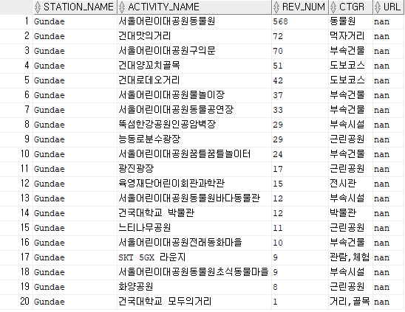
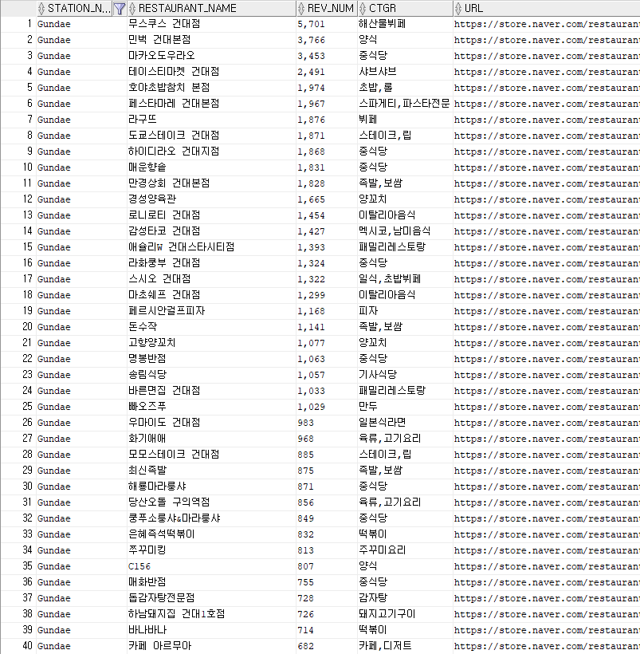
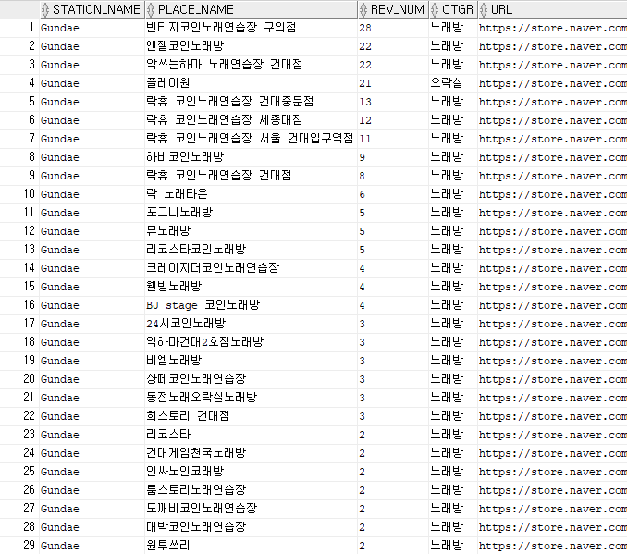
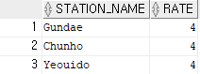
Architecture - schema
Background
<Activities>
<Restaurants>
Target
<Places>
<Stations>
Architecture
Future plan

Slide 13
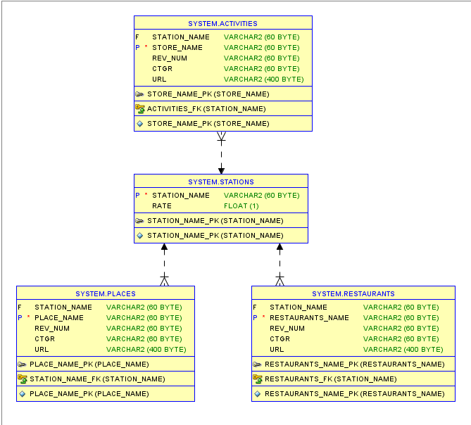
Architecture - schema
Background
Target
Architecture
Future plan

Slide 14
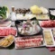
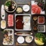
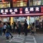
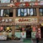
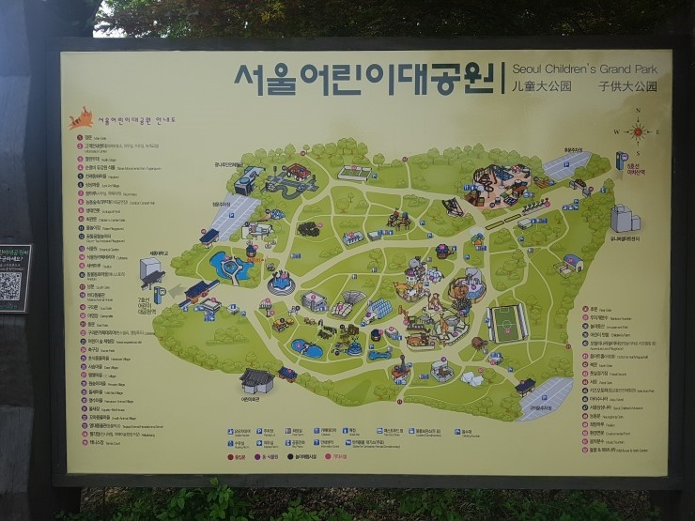
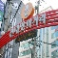
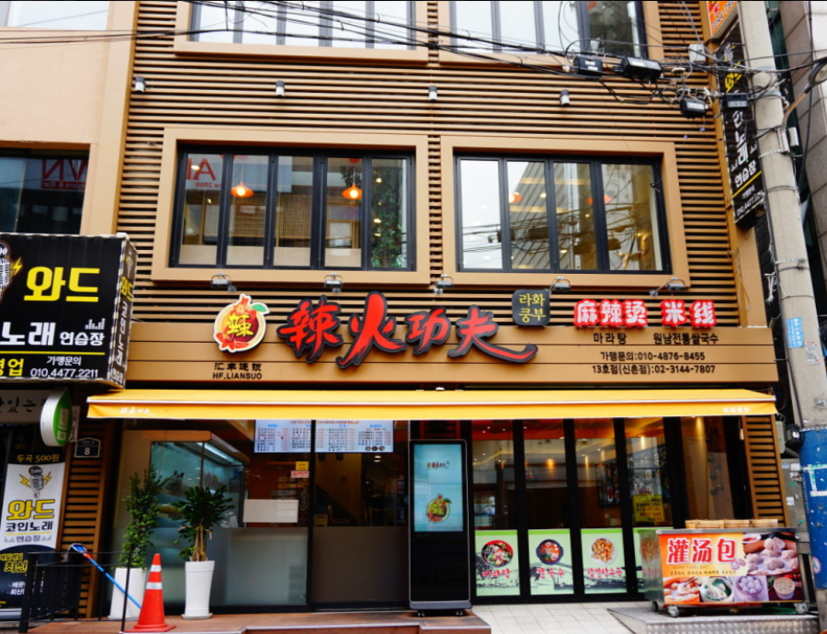
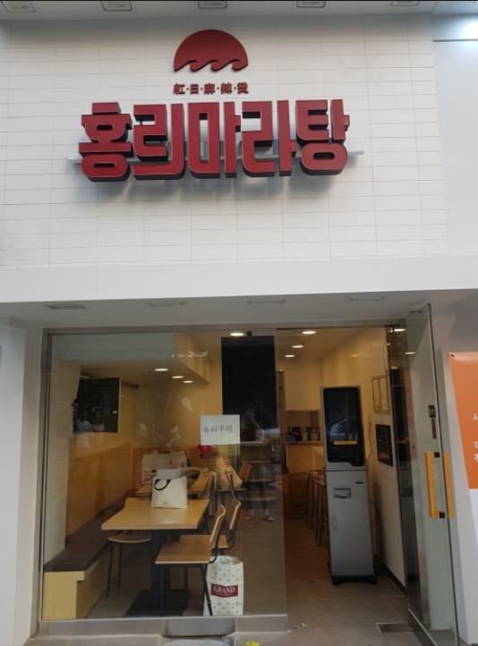
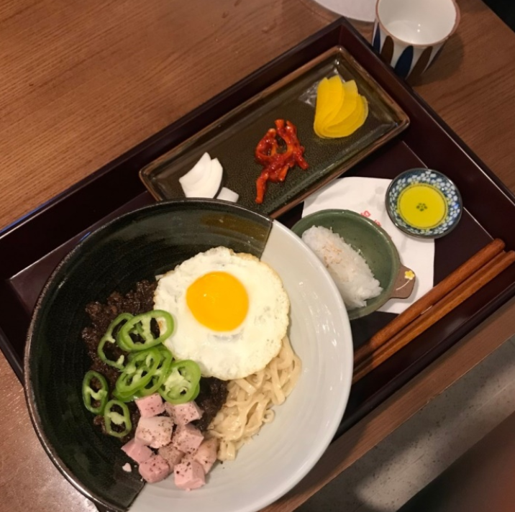
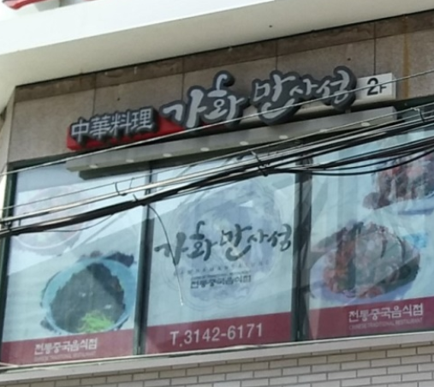
Architecture - User Interface
Background
Category
1.
건대입구역
Must-eat place
Target
Type of food
마카오도우라오
중식
하이디라오 건대점
중식
리뷰 3,453
리뷰 1,868
Korean
Western
Chinese
매운향솥
중식
라화쿵푸 건대점
중식
Japanese
Meat
Buffer
리뷰 1,831
리뷰 1,324
Pub
Entertainment
Sea food
Fast food
Attraction
어린이대공원
중식
건대 맛의거리
중식
Entertainment
리뷰 568
리뷰 72
건대 양꼬치골목
중식
건대 로데오거리
중식
리뷰 51
리뷰 42
Architecture
Singing room
PC room
Billiard hall
2.
Board game
Escape room
Theater
신촌역
Attraction
Must-eat place
라화쿵푸 신촌점
중식
홍리마라탕 신촌점
중식
리뷰 590
리뷰 478
Park
Museum, gallery
Zoo
중화반점
중식
가화만사성
중식
Famous street
Nightscape
Shopping mall
리뷰 453
리뷰 419
Entertainment
Future plan
Attraction
Notes:
After select category of each part, web page provide stations with list of each category.
When user click the name of place, web page move to the detail page of the place which is provided by Naver.

Slide 15
04
Future plan

Slide 16
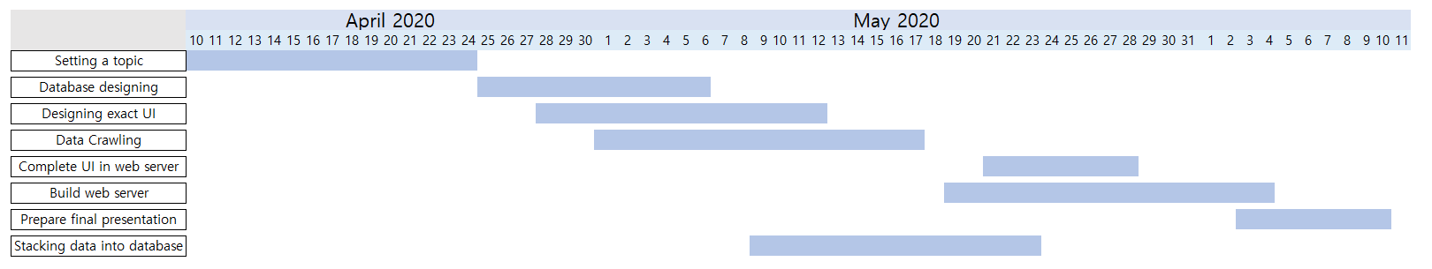
Future Plan
Background
Target
Architecture
Future plan

